Slide 1
Flappy Kart
Console Game made by Group 9

Slide 2
Task list
Player - winston
Controls
Multiuser
Enemies/boss - azar
Behavior
Spawning
UI - jj
Score
Organize stuff
Powerups - TBC
Packaging
Trophies
ID
Assets
Music
Model
Sound Effects
Background/profile image

Slide 3
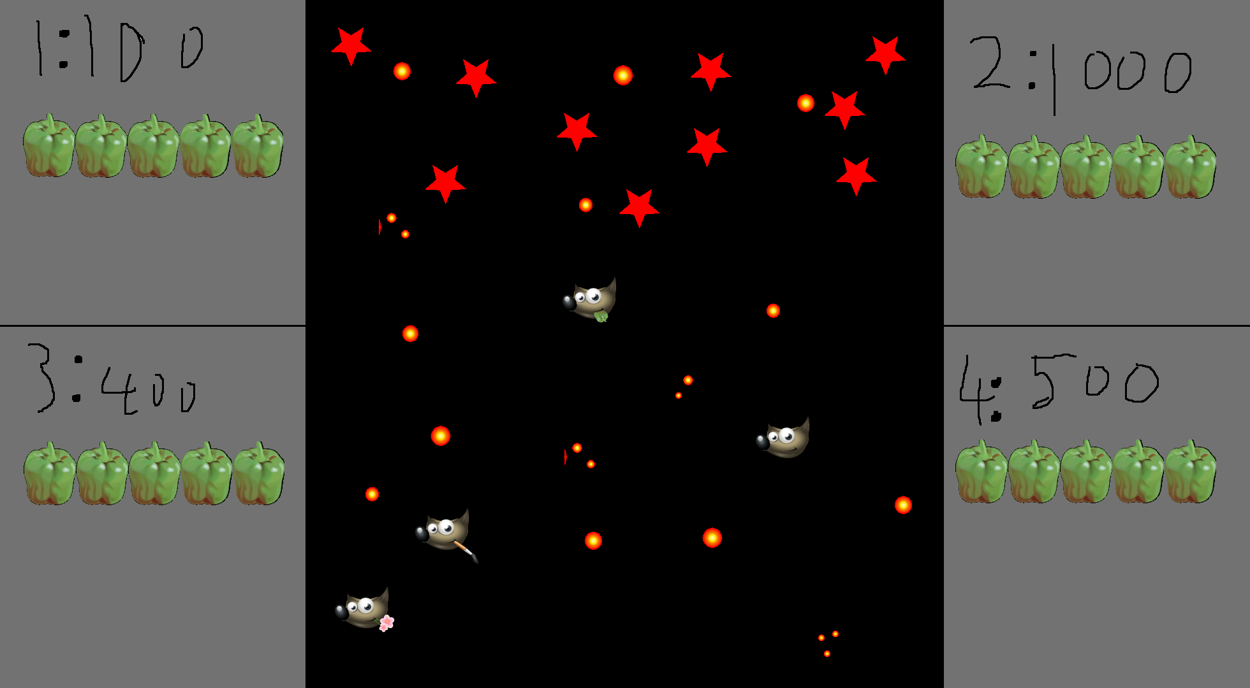
Idea: Coop Space Shooter
How to Play: Space Shooter with Multiplayer, Shoot enemies and Avoid Bullets
Mechanics:
Enemies: travels to the left while firing bullets, has health and speed
Bullet: Fires every second, upgrades increase fire rate, damage and pierce

Slide 4
Multiplayer
1 large screen, up to 4 people on the scene
Players control a ship with joystick
Left and right trigger to fire bullets
Players have 5 hp

Slide 5
Enemies
Enemy Types
Tank, cannot fire, has more health and less speed
Fighter, fires every 2s, moderate health and moderate speed
Swarm, cannot fire, 1 hp, fast speed
Others

Slide 6
UI
Score, HP and powerup

Slide 7
PowerUps - TBC
Drops randomly after killing enemies
Heal
Fire rate
Damage
Res Everyone with 1hp
Others

